Slide 1
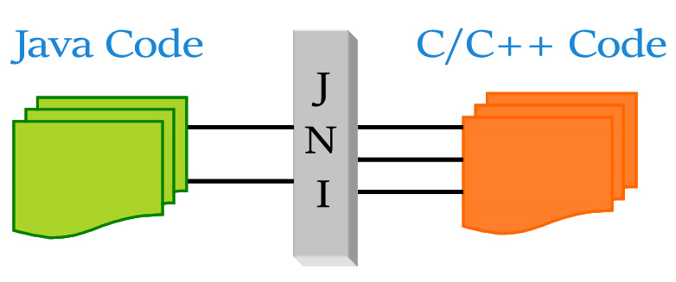
Training JNI Java Native Interface (Created by the.vu@lge.com)
Overview of Java
Introduce about JNI (Java Native Interface)
How to use JNI
JNI with Protobuf, android app
Questions and Answers
Ha Noi, 26 Nov 2019
Notes:
https://docs.oracle.com/javase/7/docs/technotes/guides/jni/spec/jniTOC.html

Slide 2

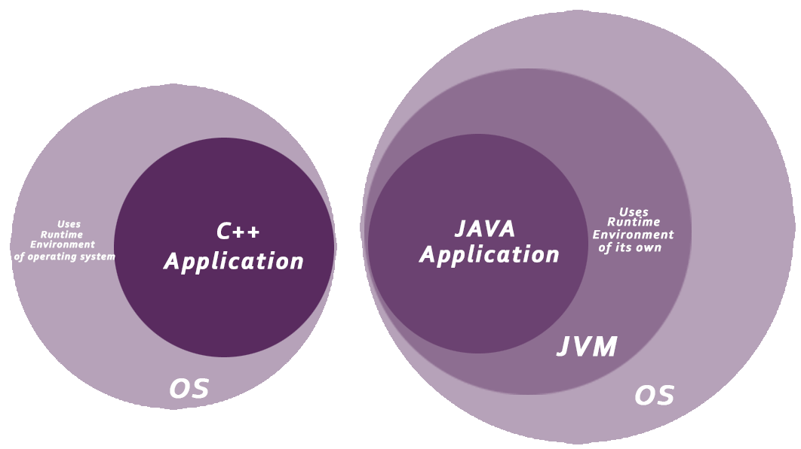
I. Overview of Java
Java is a programming language, first release is JDK 1.0 in in (January 23, 1996) and JDK 13.0.1 was already released as of 11/2019.
Java is a high level, robust, object-oriented and secure programming language.
Java was compiled to bytecode (instead of machine code
as other language as C++,C#,…) and JVM (Java Virtual Machine) will execute this bytecode on physical machine.
Sun Microsystems
(Oracle Corporation)
Notes:
https://www.javatpoint.com/java-tutorial
https://www.javatpoint.com/history-of-java

Slide 3
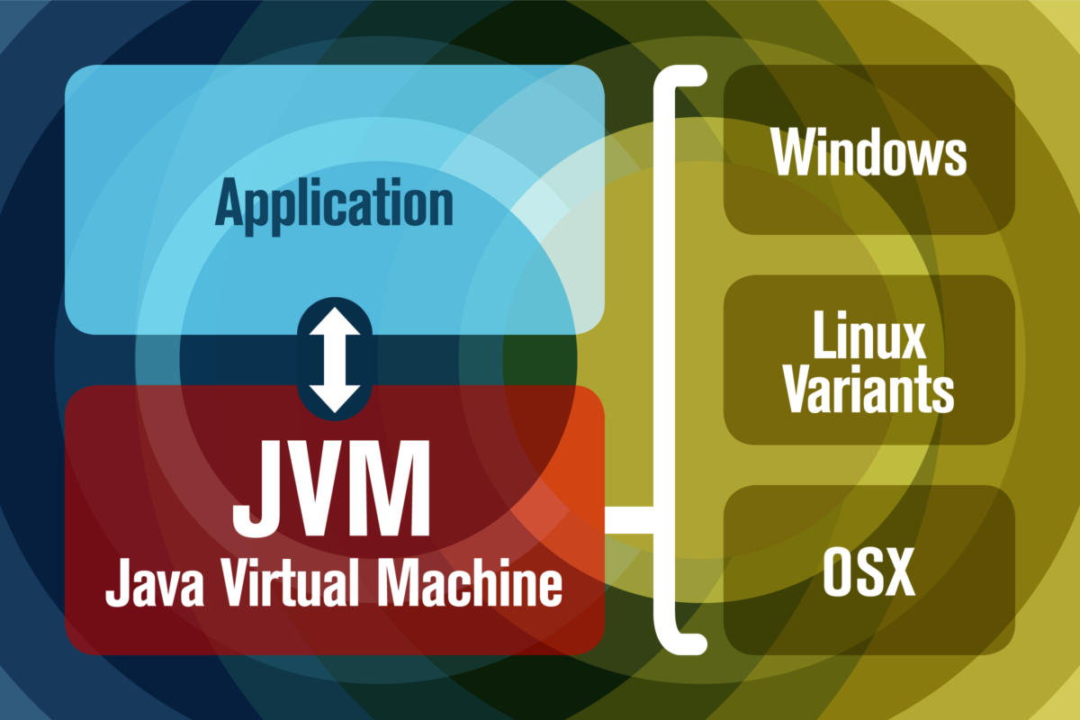
I. Overview of Java (JVM)
JVM has two primary functions:
Allow Java programs to run on any device or operating system (known as the "Write once, run anywhere" principle)
Manage and optimize program memory
Notes:
https://www.javaworld.com/article/3272244/what-is-the-jvm-introducing-the-java-virtual-machine.html

Slide 4
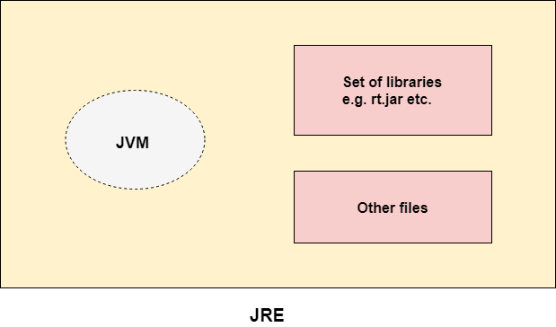
I. Overview of Java (JRE)
JRE is the implementation of JVM
JRE contains a set of libraries + other files that JVM uses at runtime.
(Java Runtime Environment)
Link: https://www.oracle.com/technetwork/java/javase/downloads/jre8-downloads-2133155.html
https://www.oracle.com/technetwork/java/javase/downloads/jdk8-downloads-2133151.html
(Notice: From Java SE 9 (9/2017), JRE was included in JDK)
Notes:
https://www.javatpoint.com/difference-between-jdk-jre-and-jvm

Slide 5
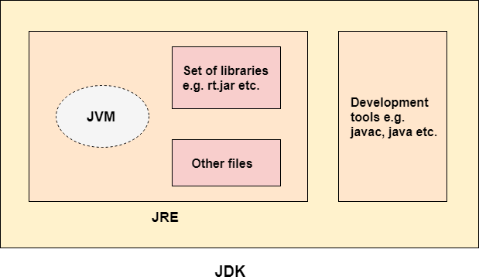
I. Overview of Java (JDK)
JDK is a software development environment which is used to develop Java applications and applets. It physically exists.
It contains JRE + development tools.
(Java Development Kit)
Link: https://www.oracle.com/technetwork/java/javase/downloads/jdk13-downloads-5672538.html
Notes:
https://www.javatpoint.com/difference-between-jdk-jre-and-jvm

Slide 6
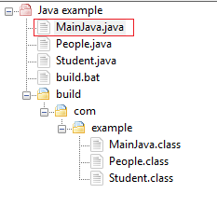
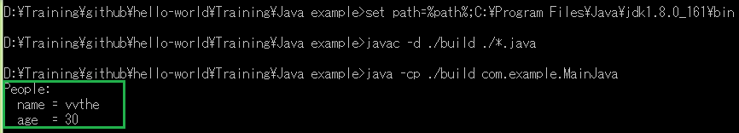
I. Overview of Java (Compile and Execute)
1. Set JDK path
set path=%path%;C:\Program Files\Java\jdk1.8.0_161\bin
2. To compile:
javac -d ./build ./*.java
3. To execute:
java -cp ./build com.example.MainJava
Notes:
https://www.codejava.net/java-core/tools/using-javac-command

Slide 7
II. Introduce about JNI (Java Native Interface)
The JNI is a native programming interface. It allows Java code that runs inside a Java Virtual Machine (VM) to interoperate with applications and libraries written in other programming languages, such as C, C++, and assembly.
Why and When ?
To access facilities of the operating system not provided via the standard Java libraries.
You have some library or code already written in C/C++ that you want to interface with without porting it to Java.
In a few rare cases where there is a proven performance benefit (e.g. because you know your particular C compiler can optimise some particular code better than the JVM's JIT compiler).
Notes:
https://www3.ntu.edu.sg/home/ehchua/programming/java/JavaNativeInterface.html

Slide 8
III. How to use JNI
Notes:
https://www3.ntu.edu.sg/home/ehchua/programming/java/JavaNativeInterface.html

Slide 9
Thank you

